Slide 1
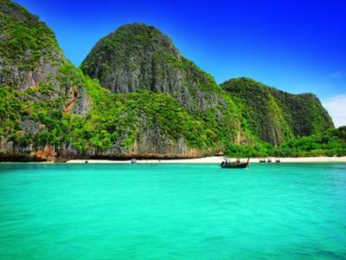
Koh Lanta

Slide 2
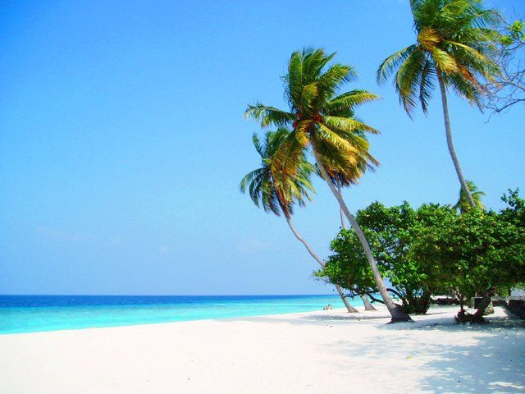
Koh Lanta

Slide 3
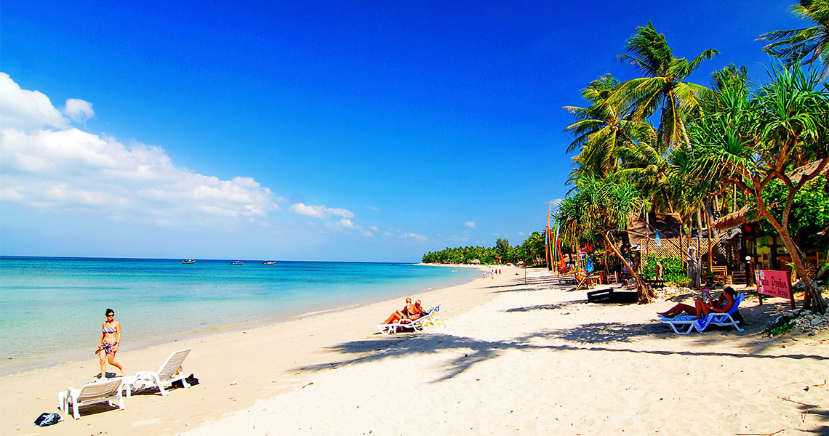
Khlong Khong Beach Koh Lanta

Slide 4
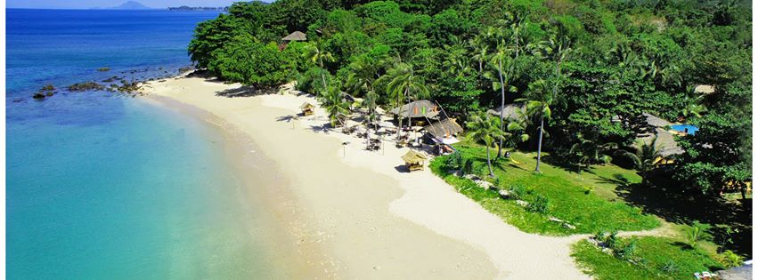
Relax bay resort Koh Lanta

Slide 5
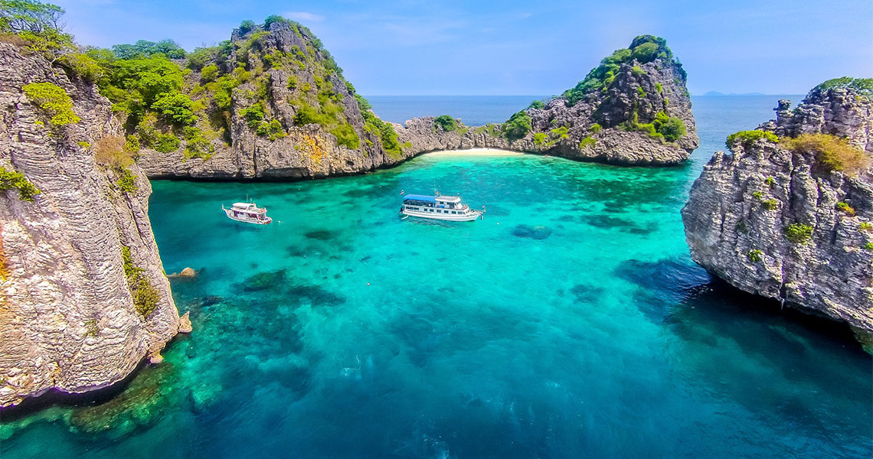
Koh Haa Snorkeling and Scuba Diving
One Day Tours from Koh Lanta

Slide 6
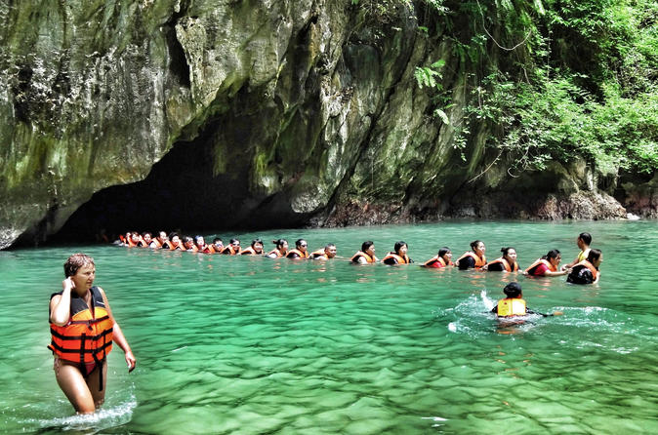
4 island tour from Koh Lanta

Slide 7
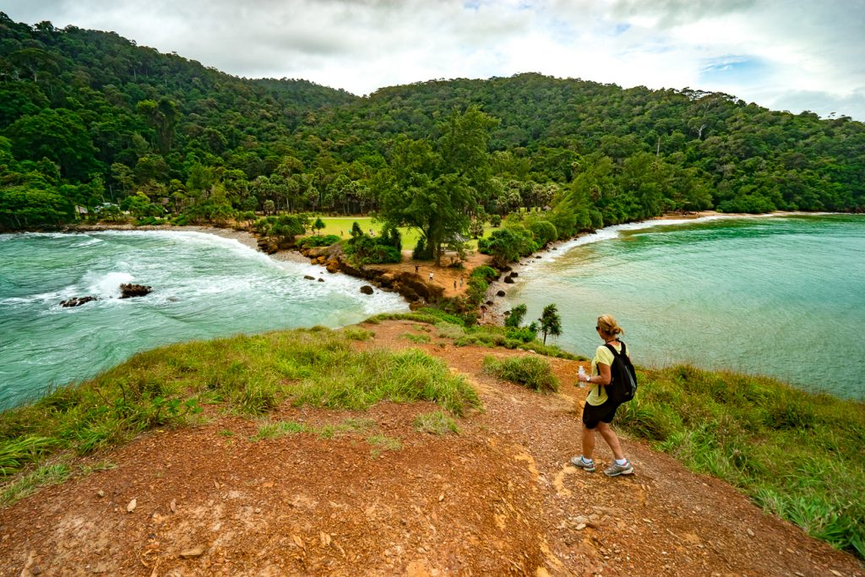
Koh Lanta

Slide 8
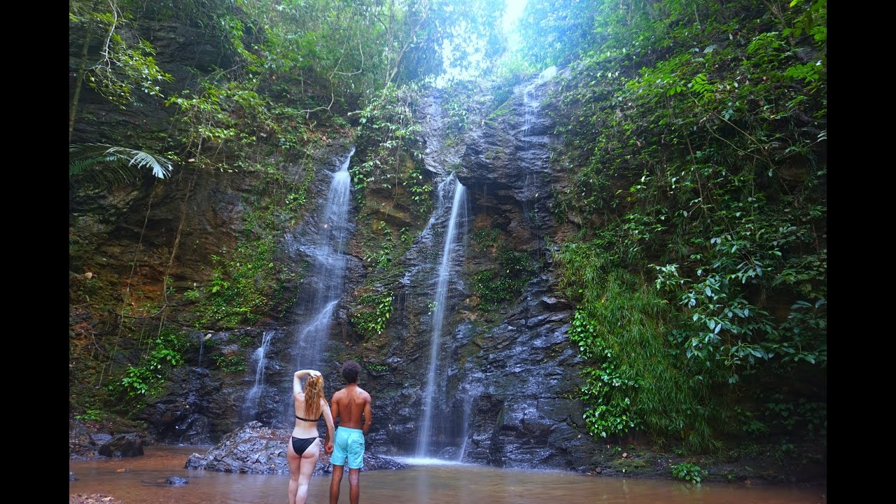
Koh Lanta waterfall

Slide 9
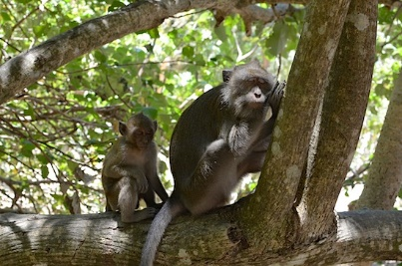
Koh Lanta National Park

Slide 10
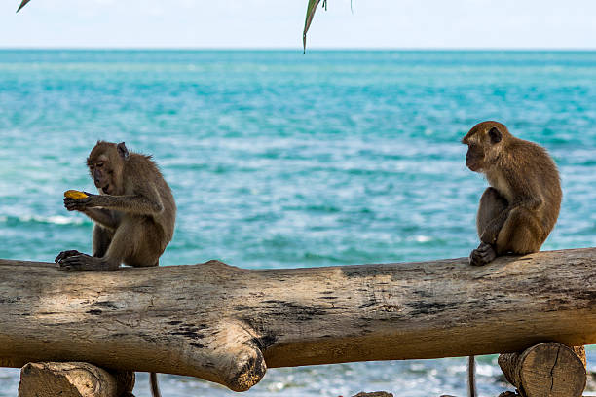
Koh Lanta monkeys

Slide 11
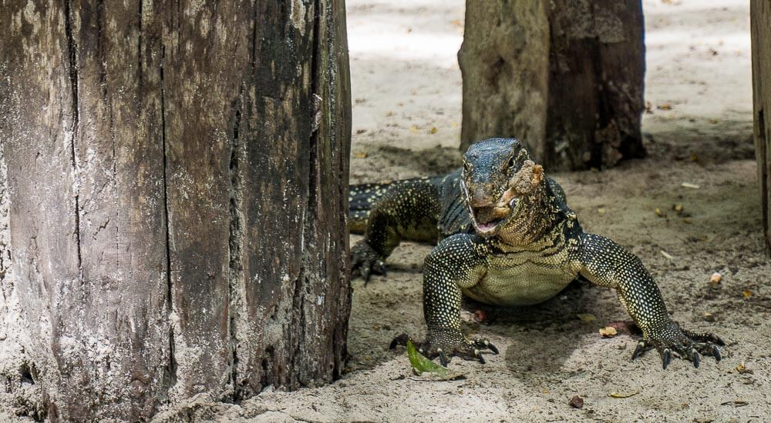
Monitor lizard Koh Lanta

Slide 12
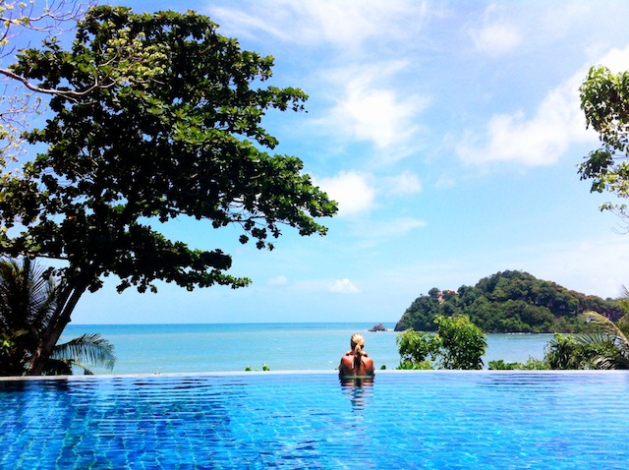
Koh Lanta swim

Slide 13
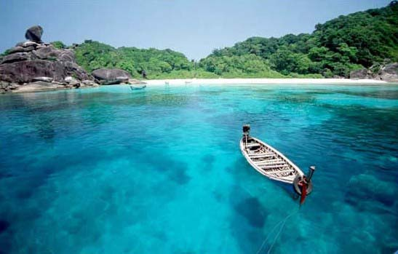
Koh Lanta

Slide 14
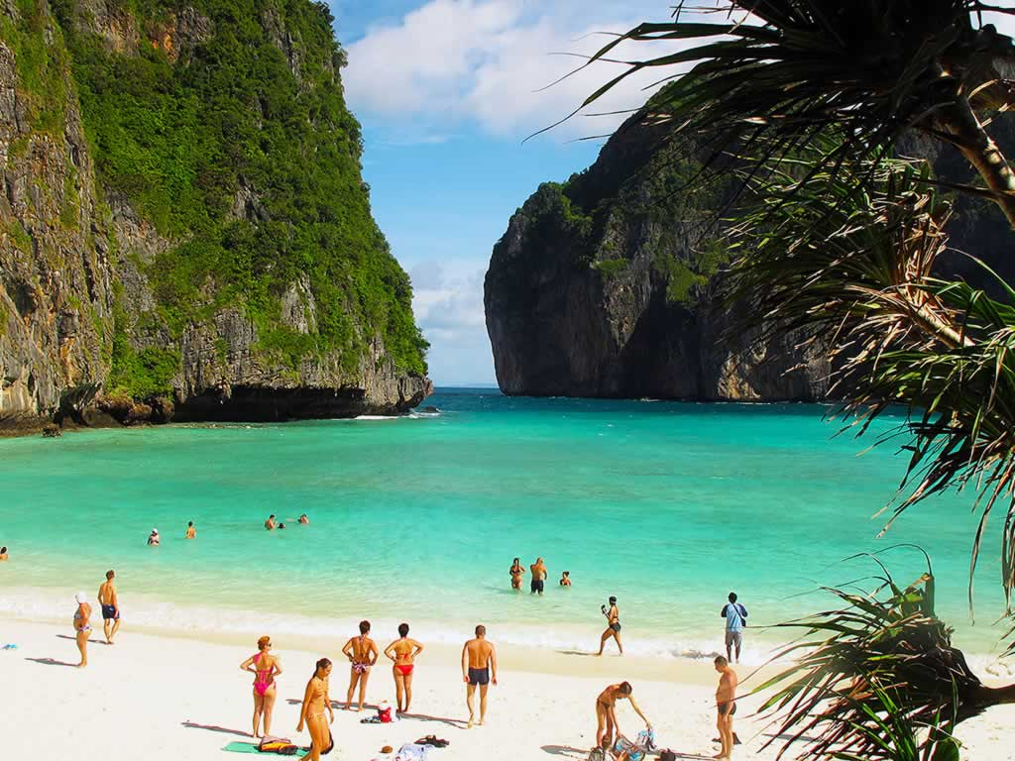
Phi Phi Island Tour Koh Lanta

Slide 15
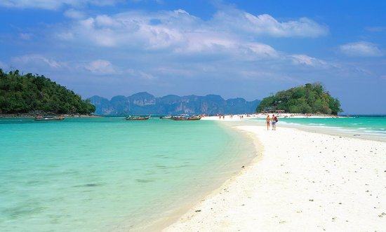
Koh Lanta

Slide 16
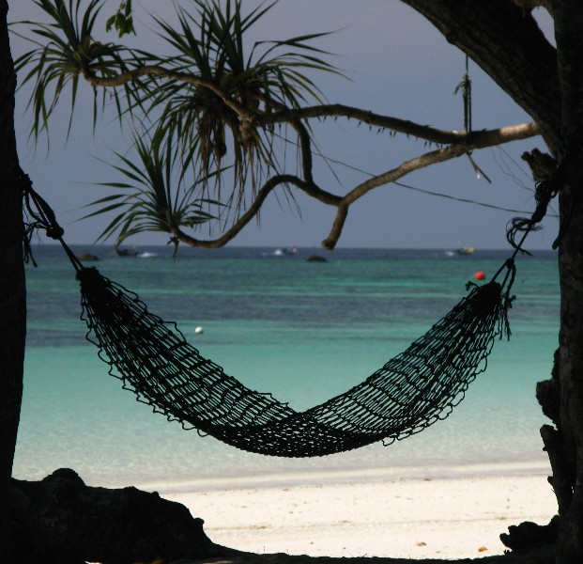
Koh Lanta

Slide 17

Sunset Koh Lanta

Slide 18
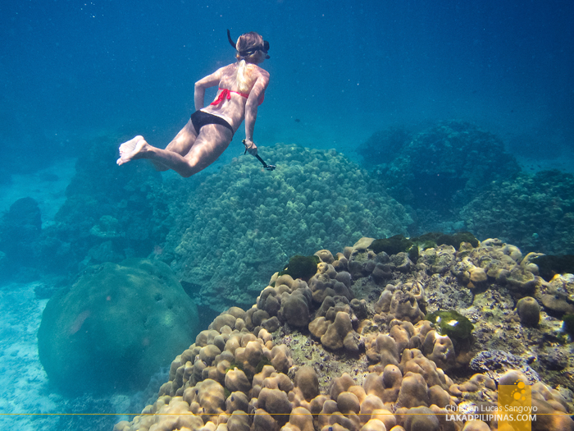
Snorkelling

Slide 19
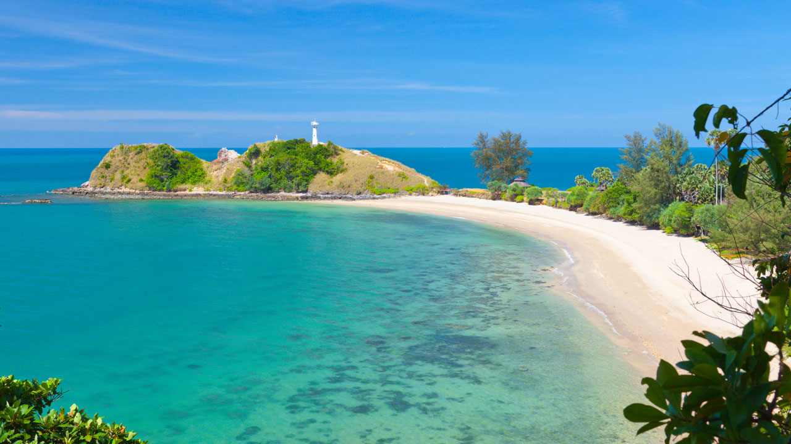
Koh Lanta

