Slide 1
Doi suthep

Slide 2
Doi suthep

Slide 3
Doi Suthep

Slide 4
Doi Suthep

Slide 5
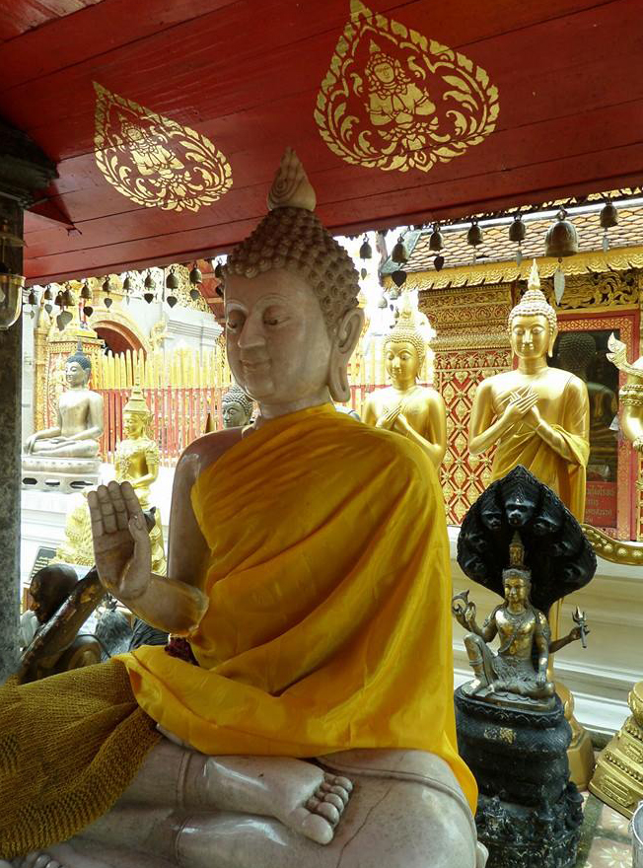
Doi Suthep

Slide 6
Doi Suthep

Slide 7
Doi Suthep

Slide 8
Doi Suthep

Slide 9
Doi suthep hike

Slide 10
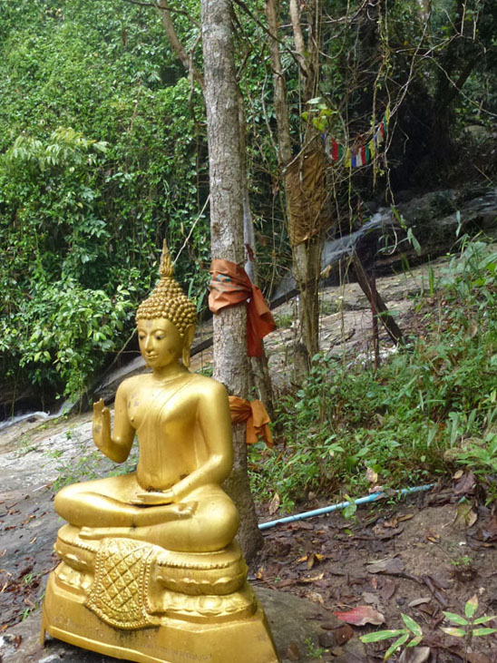
Doi suthep hike

Slide 11
Doi suthep hike

Slide 12
Doi suthep hike

Slide 13
Doi pui hmong village

Slide 14
Hmong village

Slide 15
Hmong

Slide 16
Hmong Hill tribe

Slide 17
Hmong woman

Slide 18
White Hmong Hill Tribe

Slide 19
Tribal

Slide 20
Wat Phra That Doi Suthep temple

