Slide 1
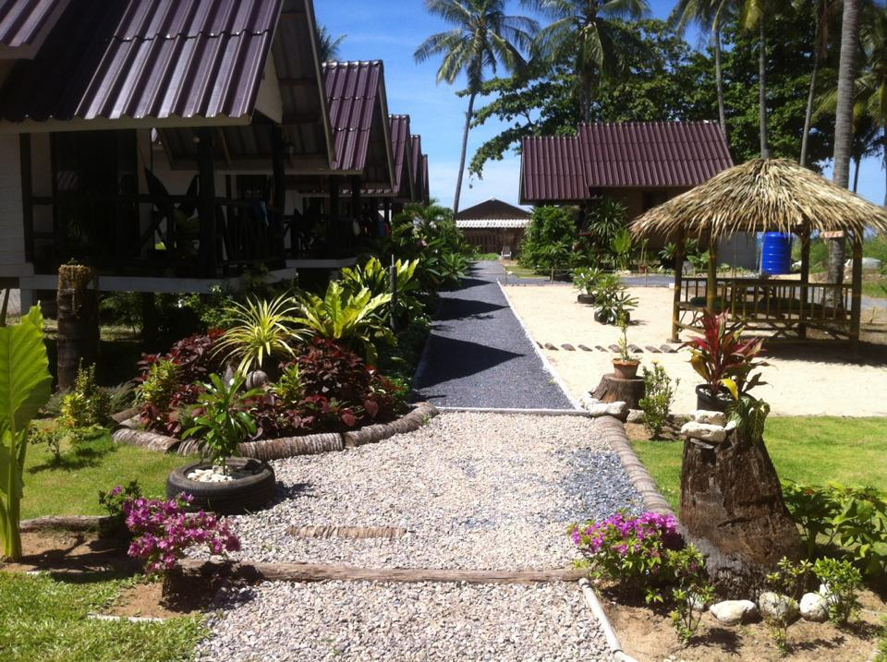
Koh Lanta accommodation

Slide 2
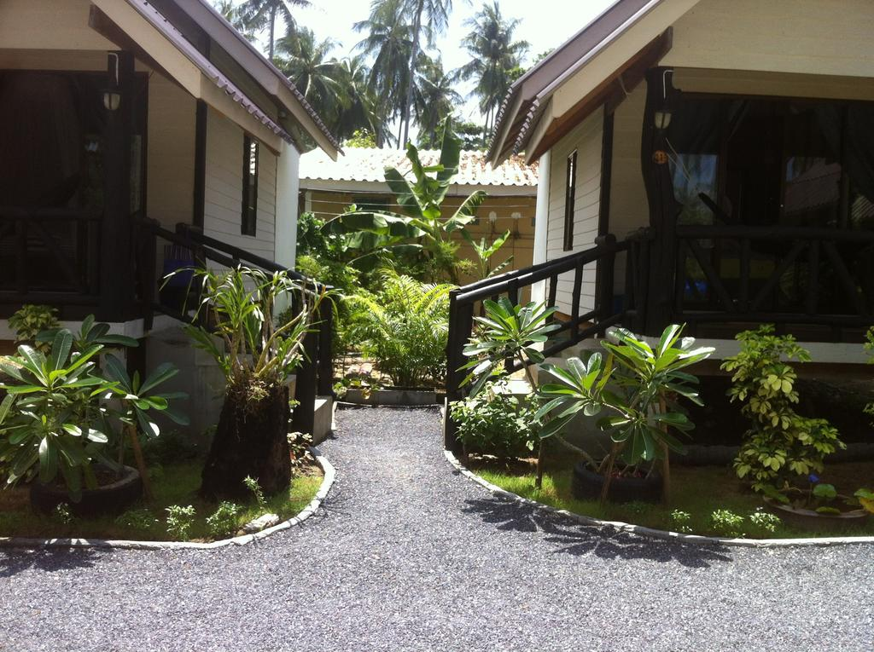
Koh Lanta accommodation

Slide 3
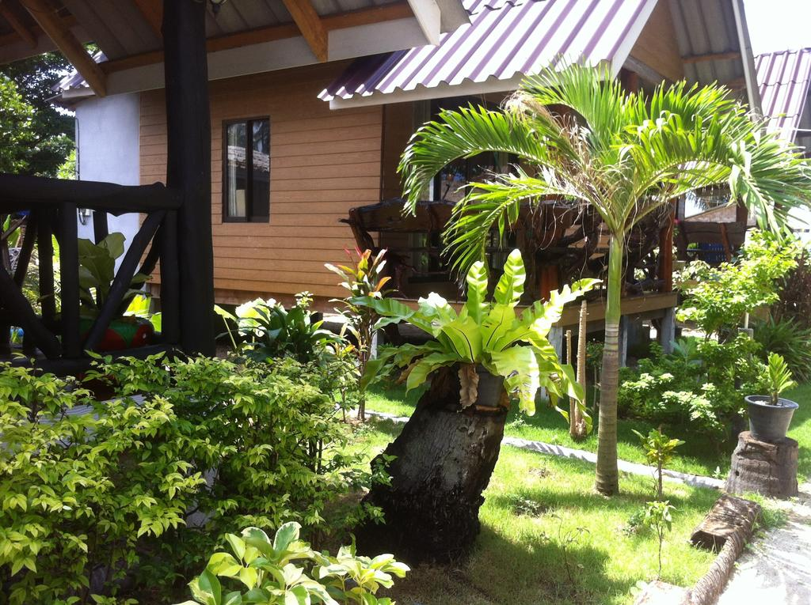
Koh Lanta accommodation

Slide 4
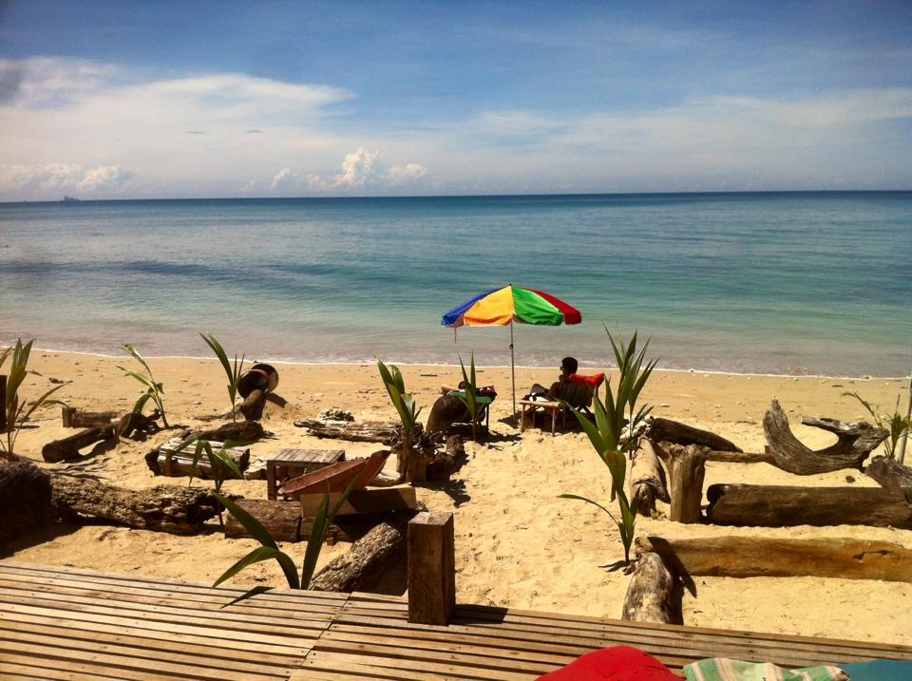
Koh Lanta accommodation

Slide 5
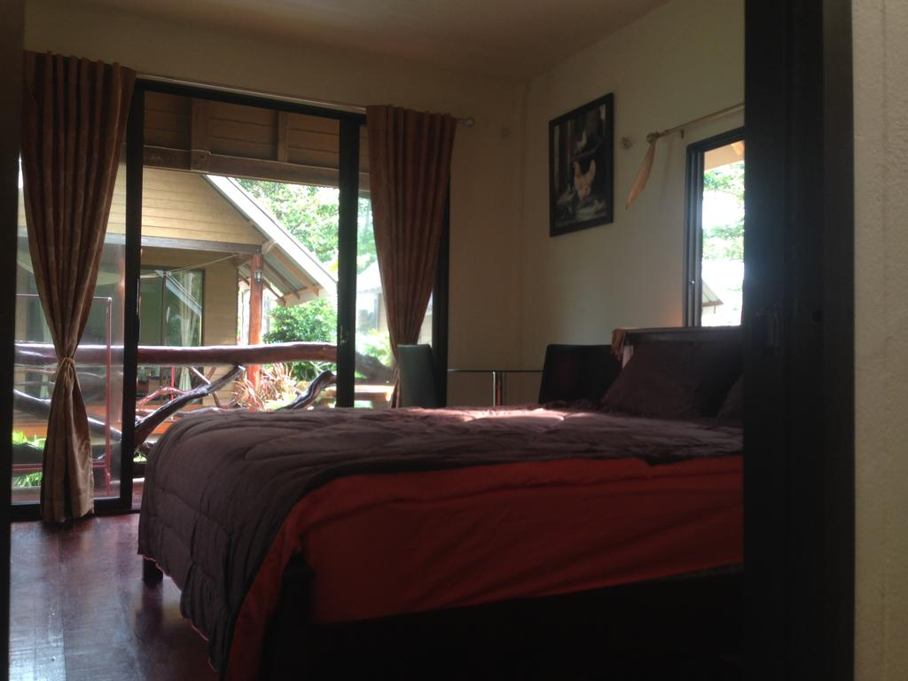
Koh Lanta accommodation

Slide 6
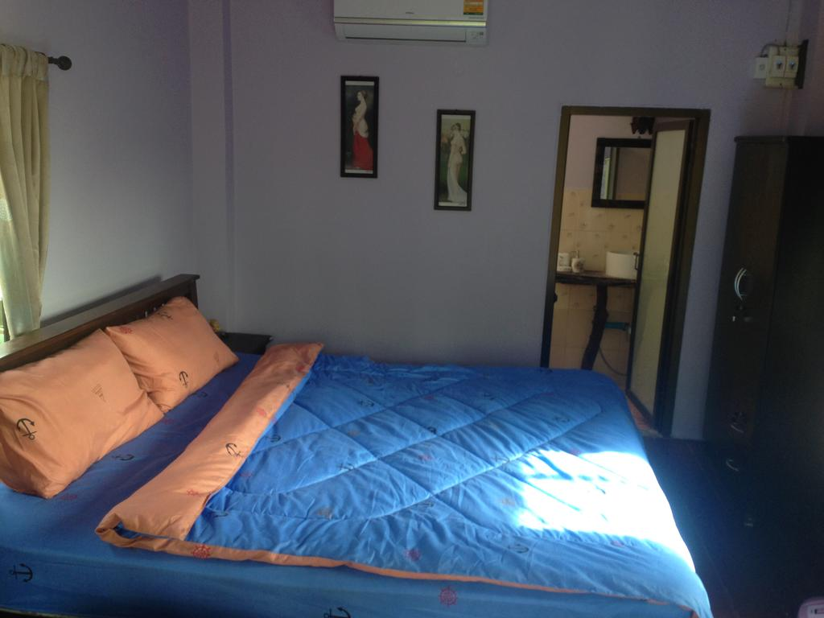
Koh Lanta accommodation

Slide 7
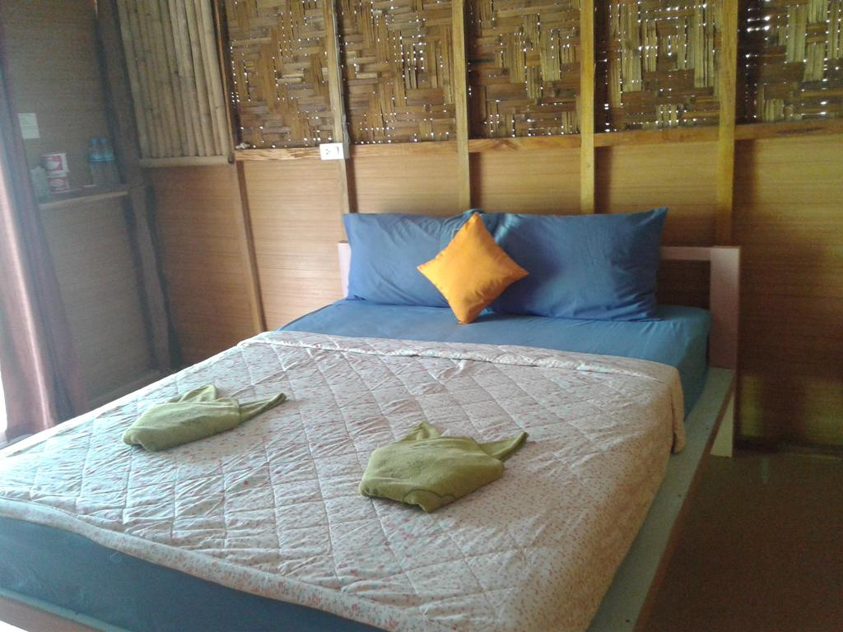
Koh Lanta accommodation

Slide 8
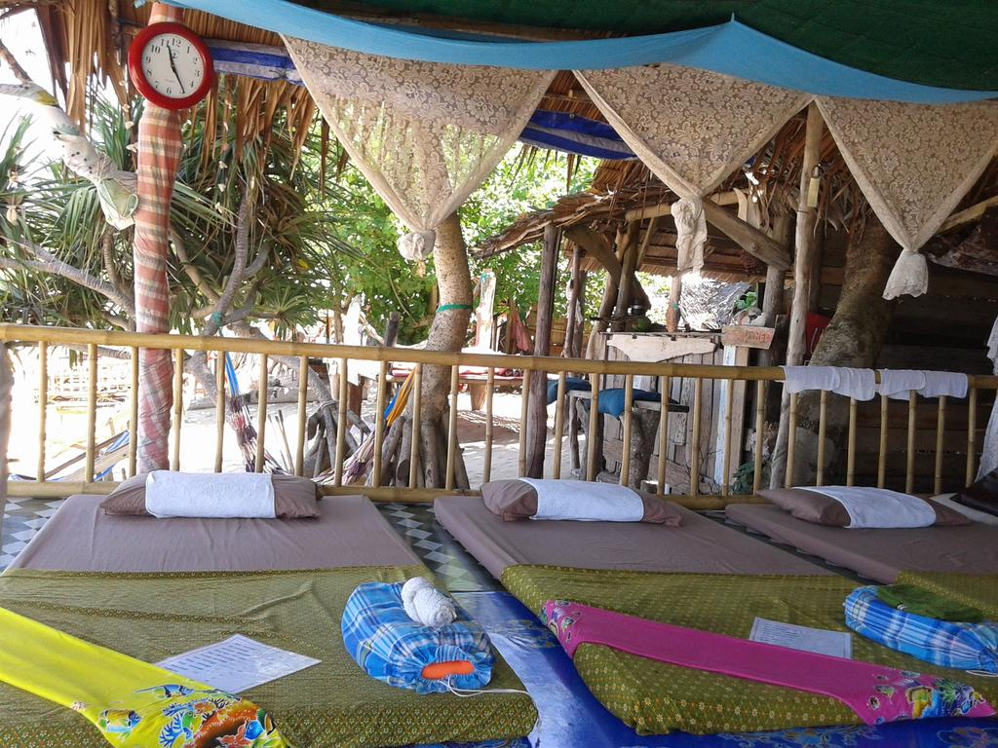
Koh Lanta accommodation

Slide 9
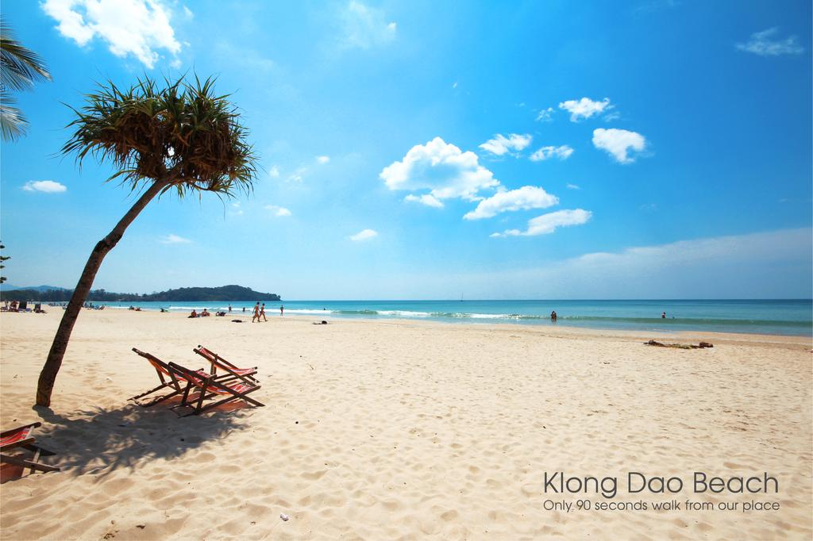
Koh Lanta accommodation

Slide 10
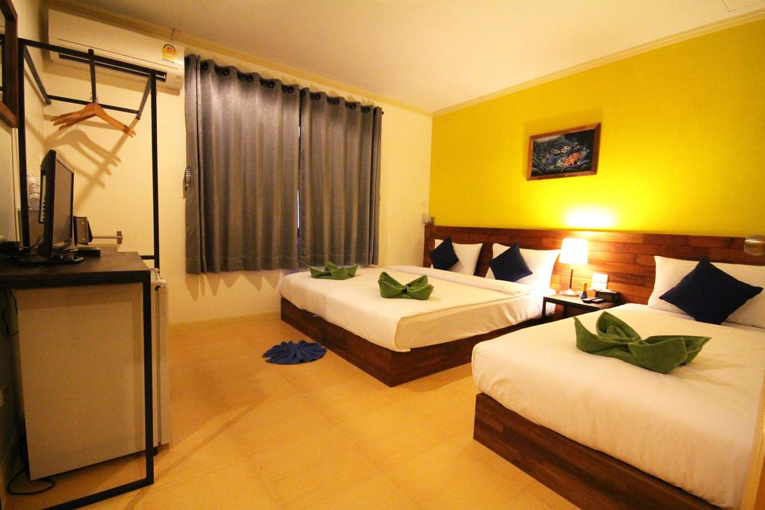
Koh Lanta accommodation

Slide 11
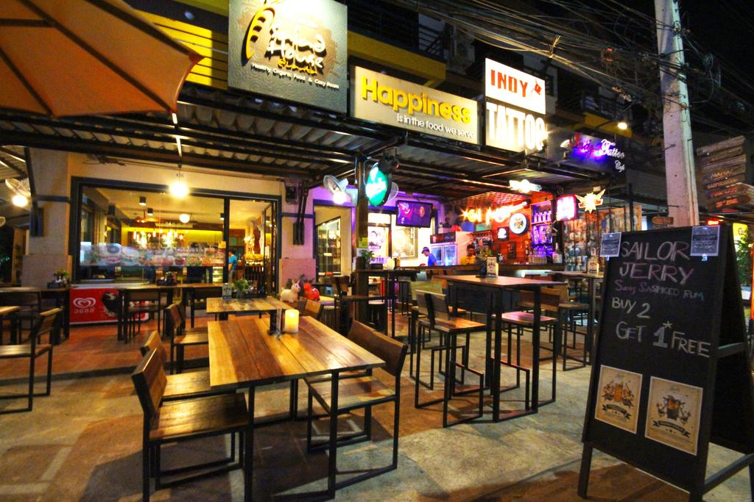
Koh Lanta accommodation

Slide 12
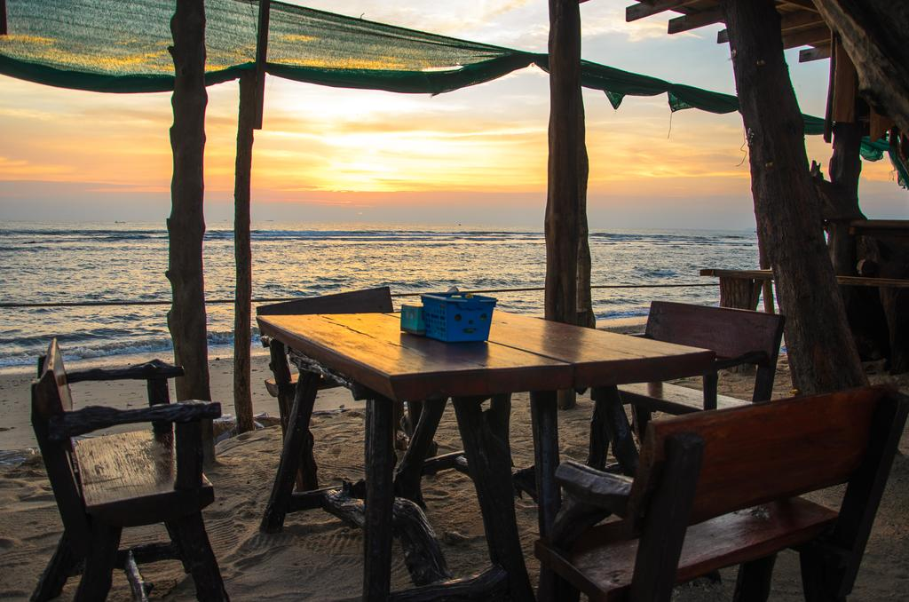
Koh Lanta accommodation

Slide 13
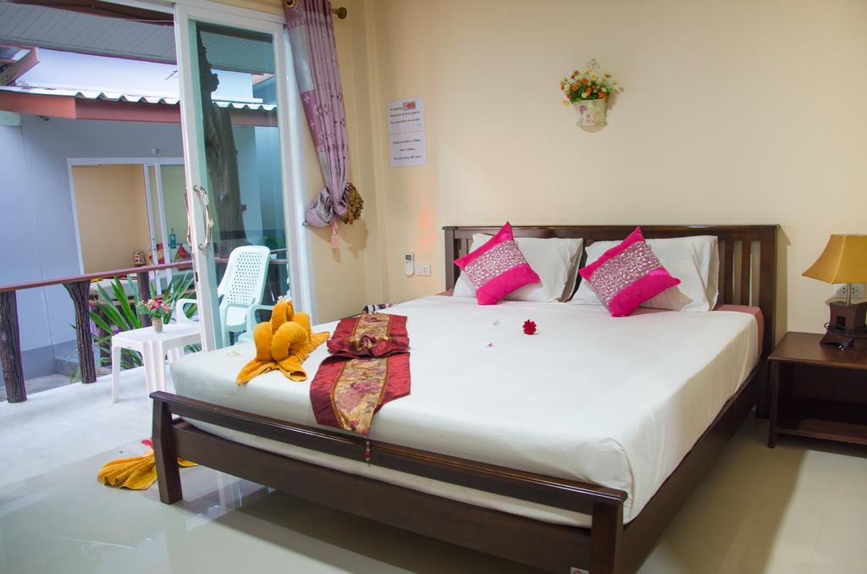
Koh Lanta accommodation

Slide 14
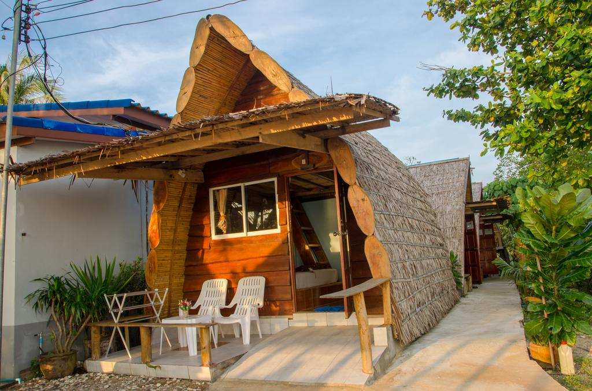
Koh Lanta accommodation

Slide 15
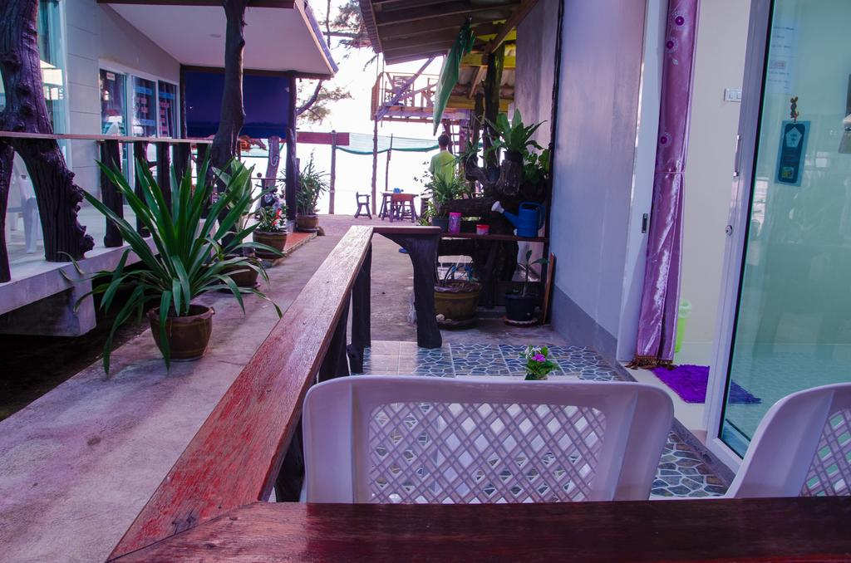
Koh Lanta accommodation

Slide 16
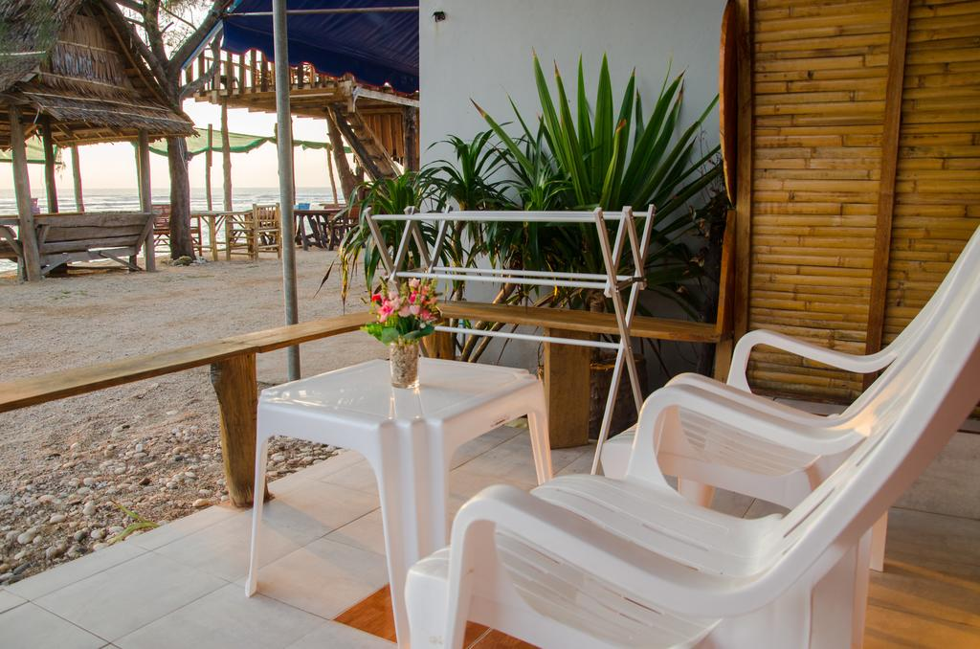
Koh Lanta accommodation

Slide 17
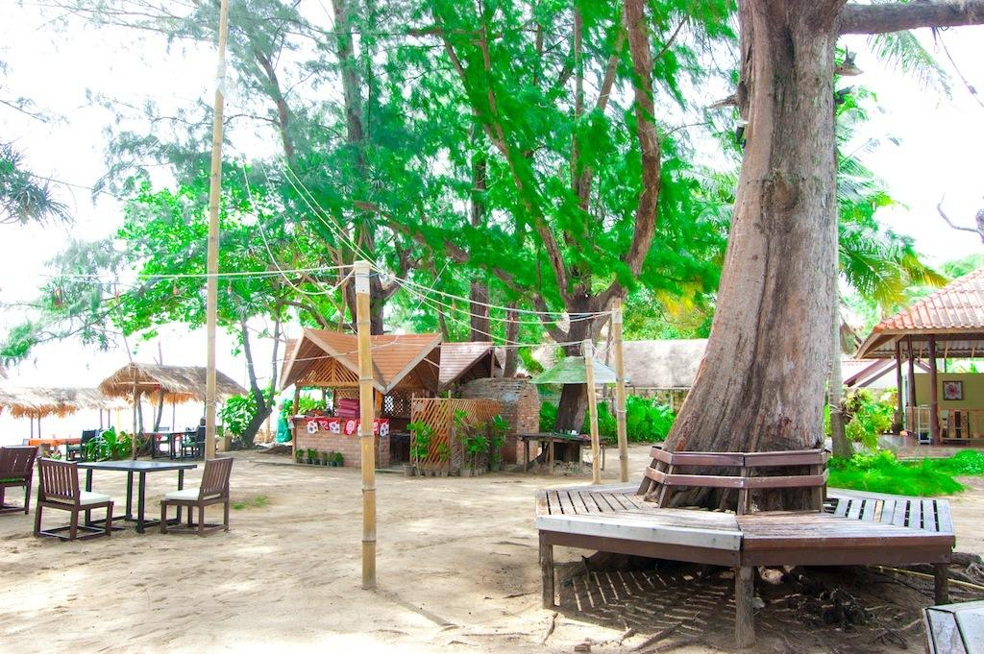
Koh Lanta accommodation

Slide 18
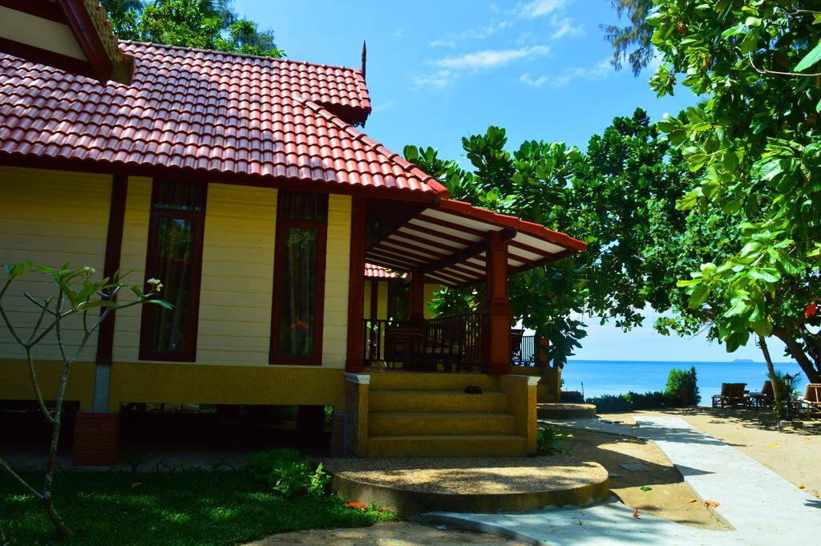
Koh Lanta accommodation

Slide 19
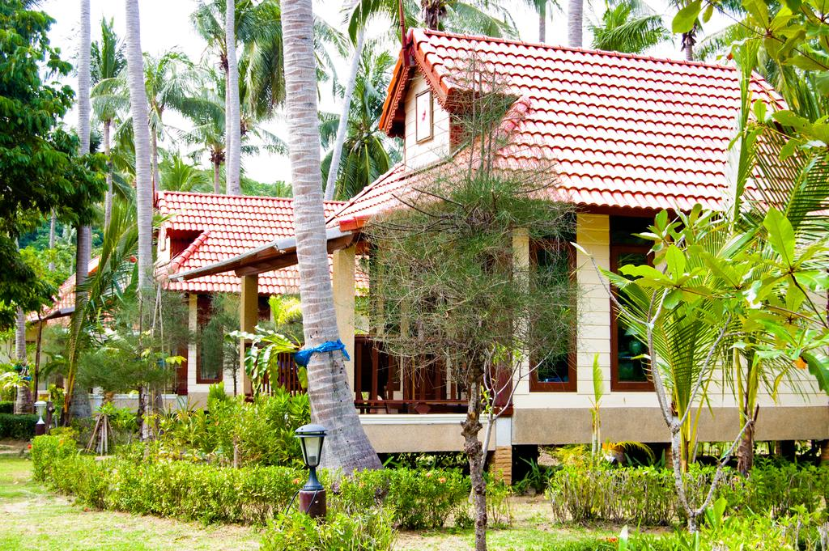
Koh Lanta accommodation

Slide 20
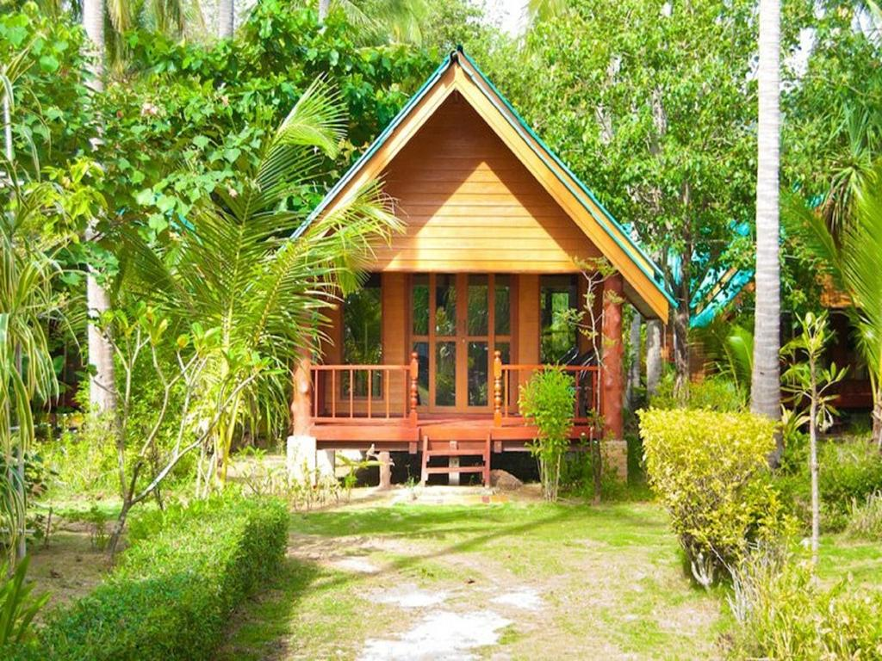
Koh Lanta accommodation

Slide 21
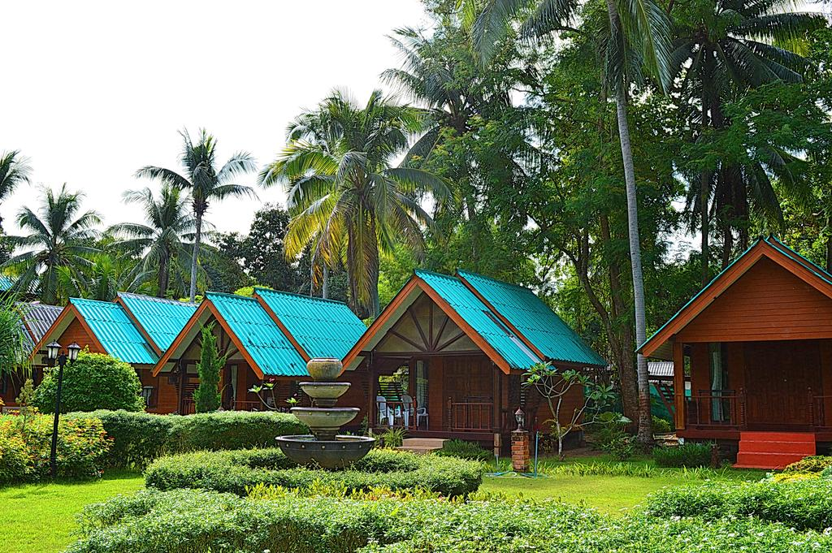
Koh Lanta accommodation

Slide 22
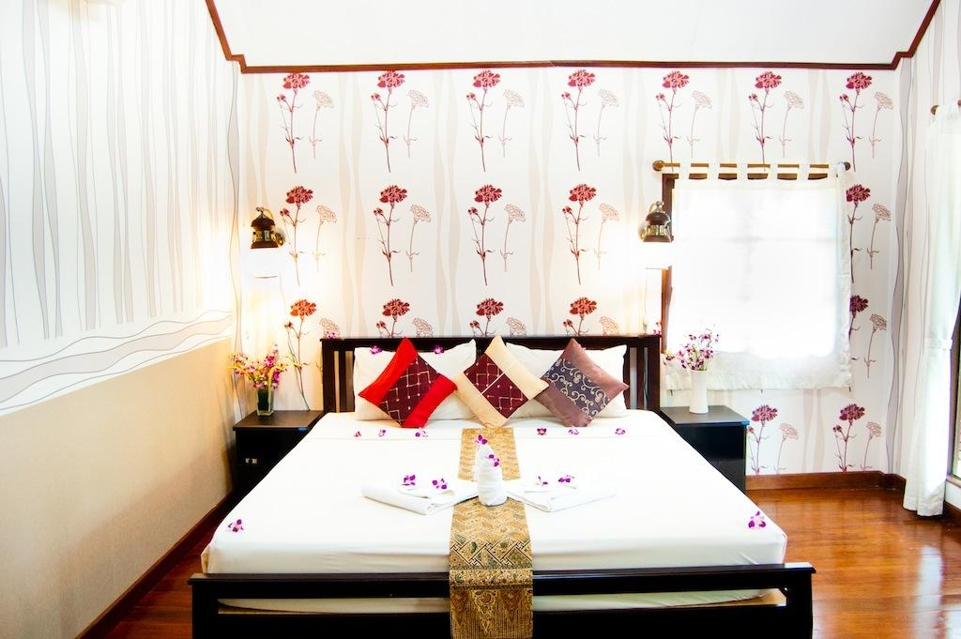
Koh Lanta accommodation

Slide 23
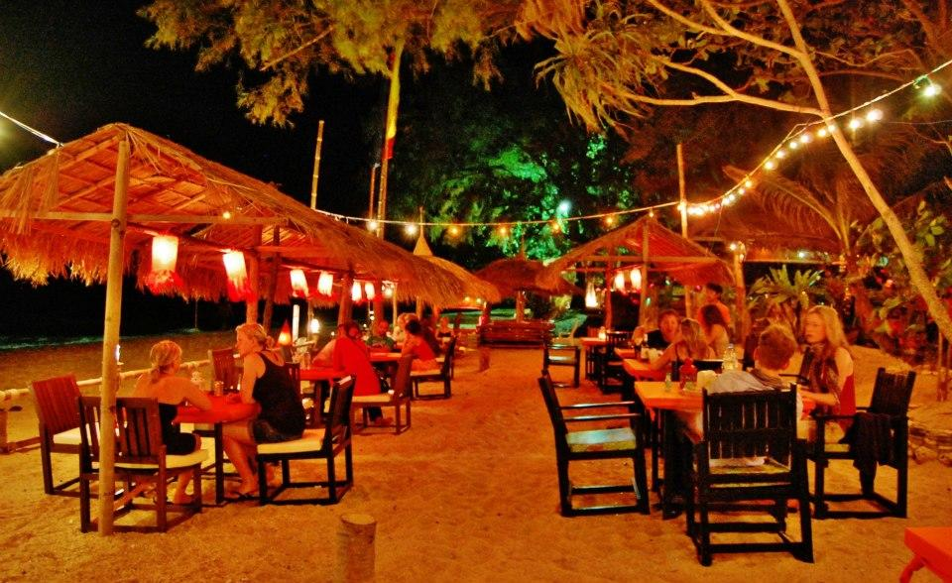
Koh Lanta accommodation

Slide 24
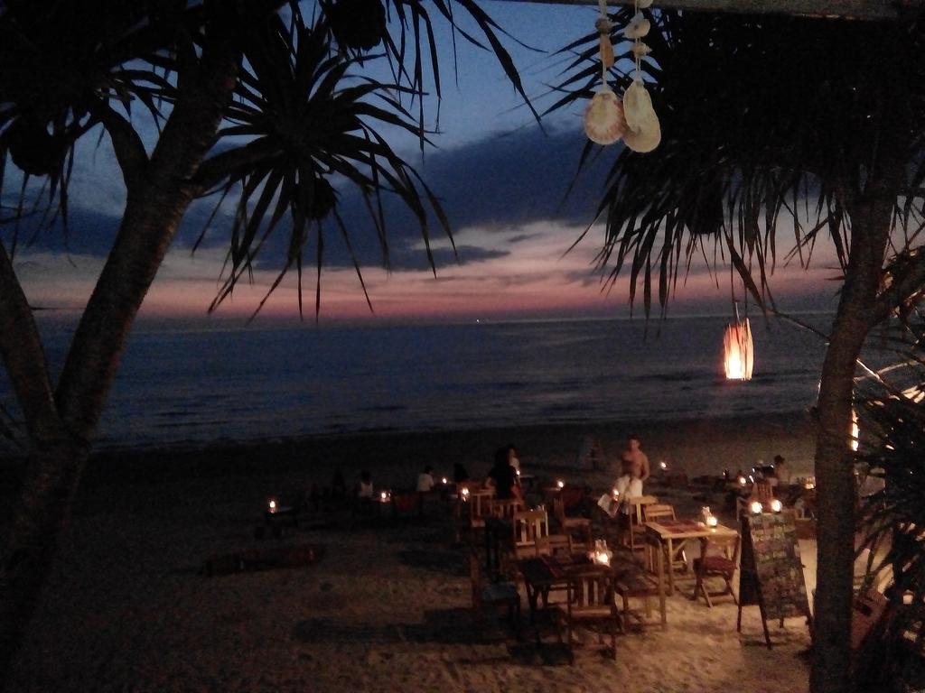
Koh Lanta accommodation

Slide 25
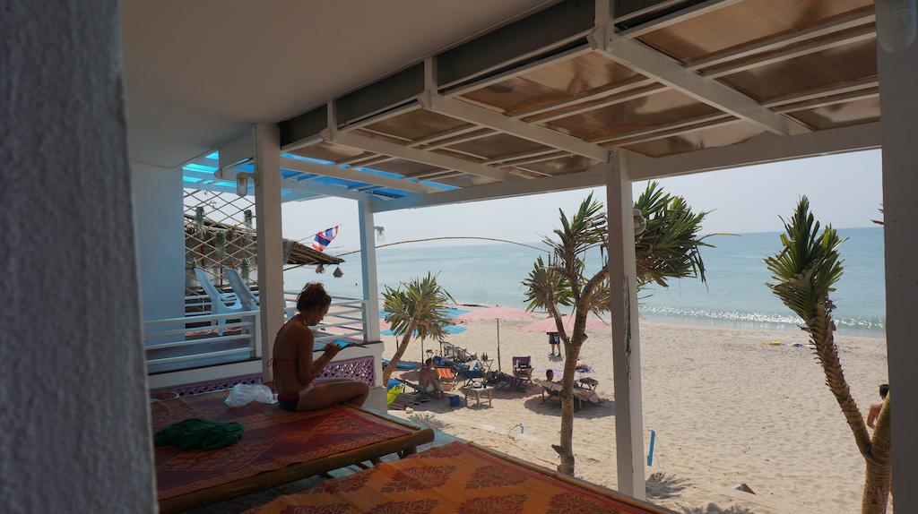
Koh Lanta accommodation

Slide 26
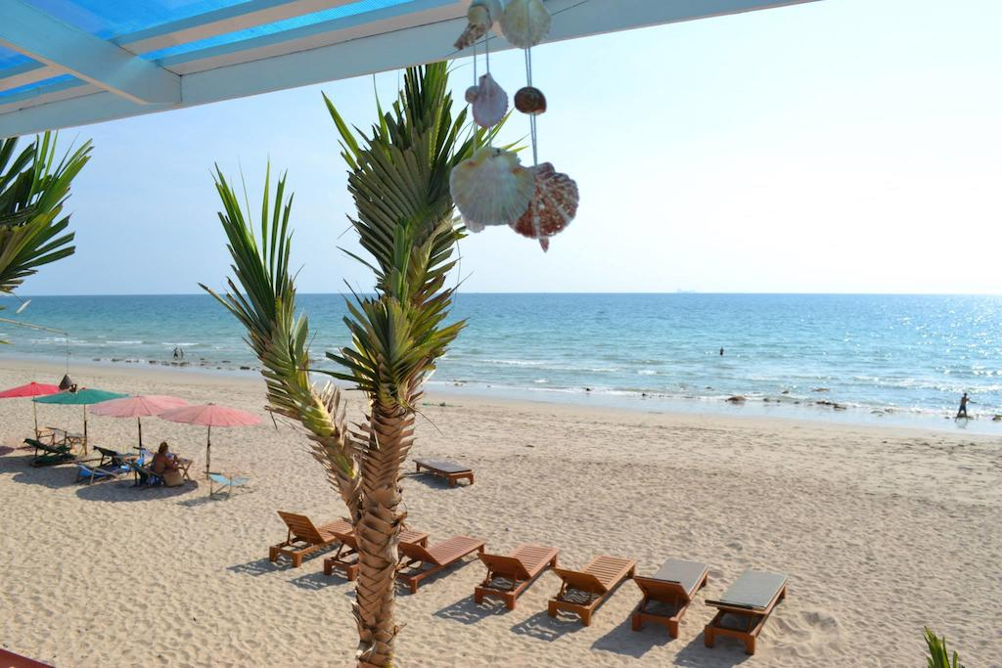
Koh Lanta accommodation

Slide 27
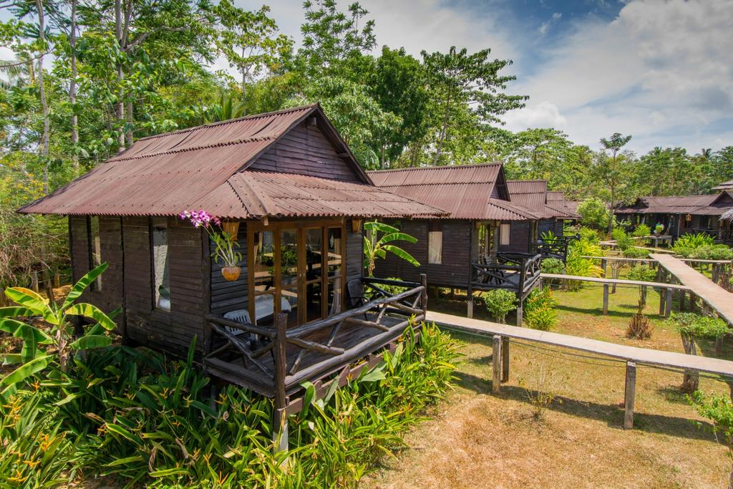
Koh Lanta accommodation

Slide 28
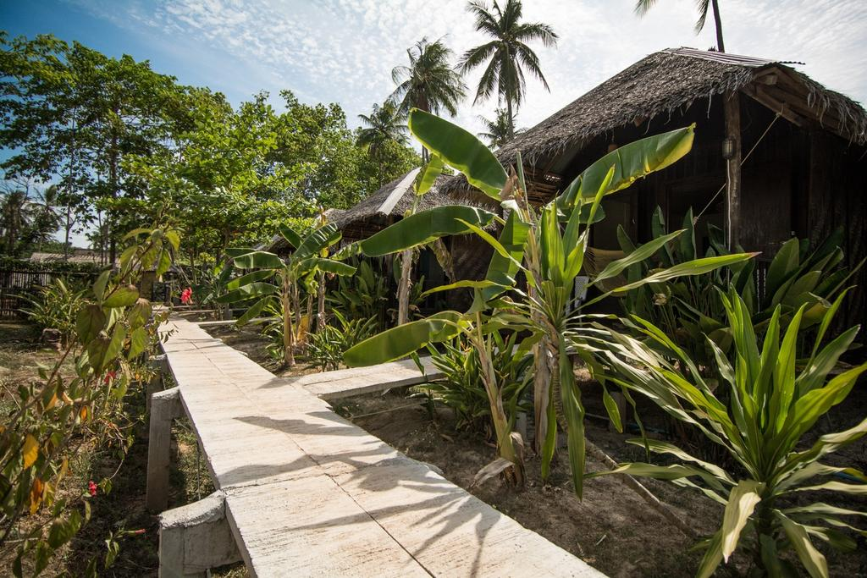
Koh Lanta accommodation

Slide 29
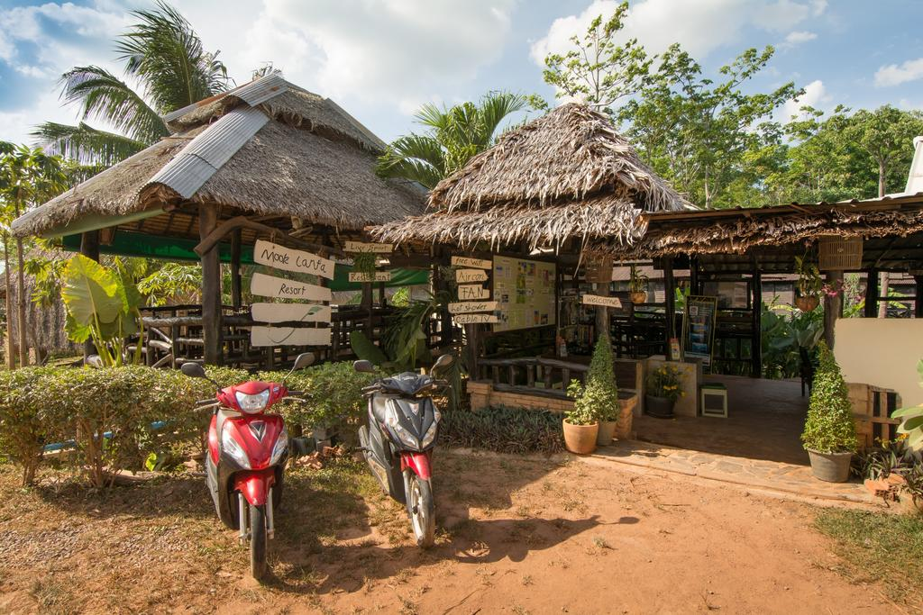
Koh Lanta accommodation

Slide 30
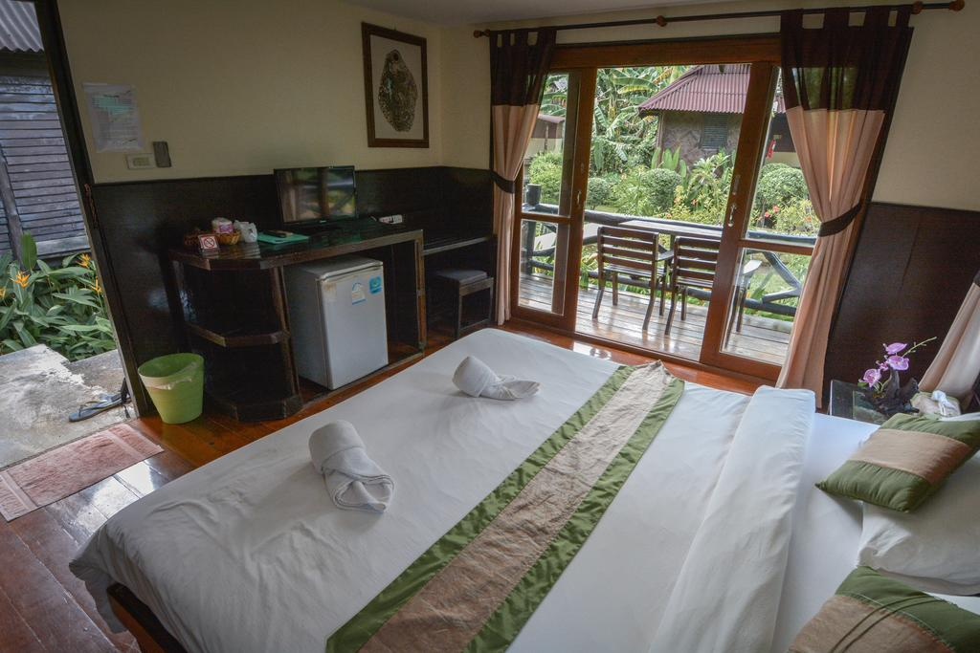
Koh Lanta accommodation

Slide 31
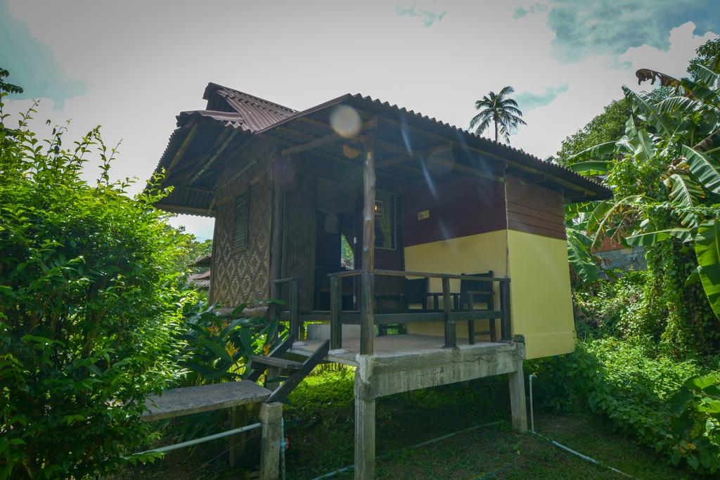
Koh Lanta accommodation

